Slide 1
Sequence Diagram

Slide 2
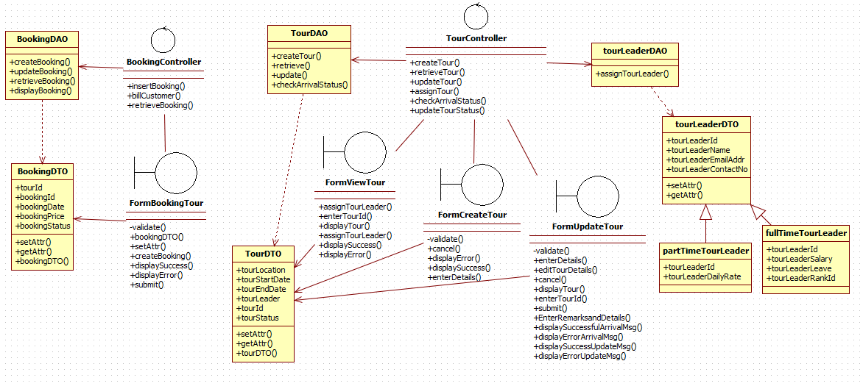
Class Diagram - Assign Tour Leader, Create Tour, Book Tour, Depart Tour, Complete Tour
SAMPLE DONT TOUCH!

Slide 3
Department Web

Slide 4
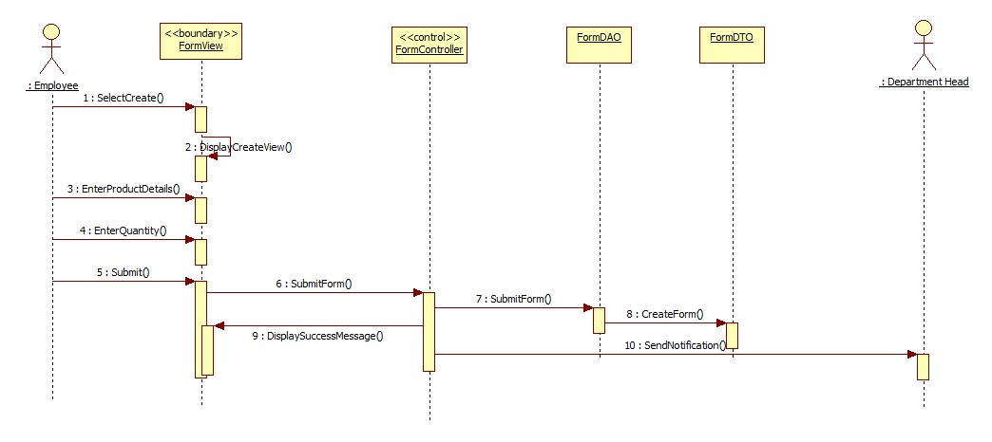
Create Requisition Form

Slide 5
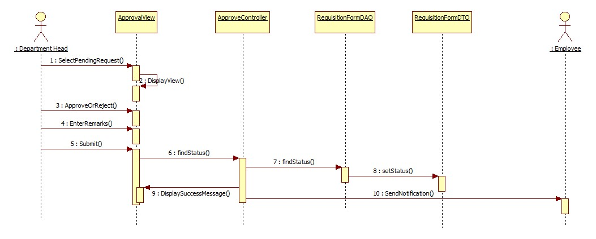
Approve Requisition Form

Slide 6
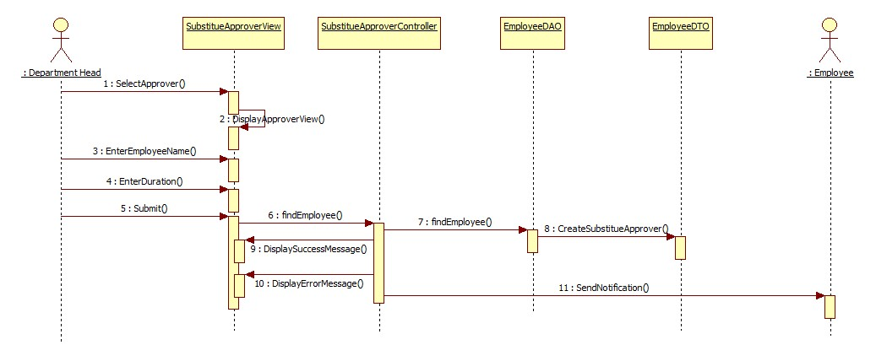
Appoint Substitute Approver and notification

Slide 7
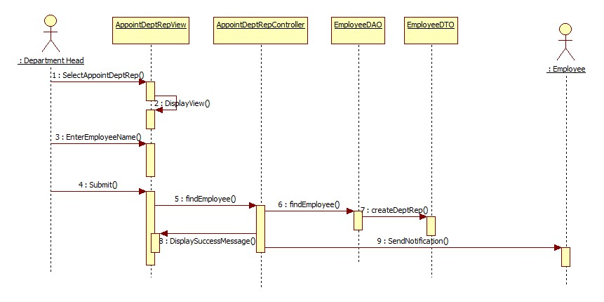
Appoint Department Representative

Slide 8
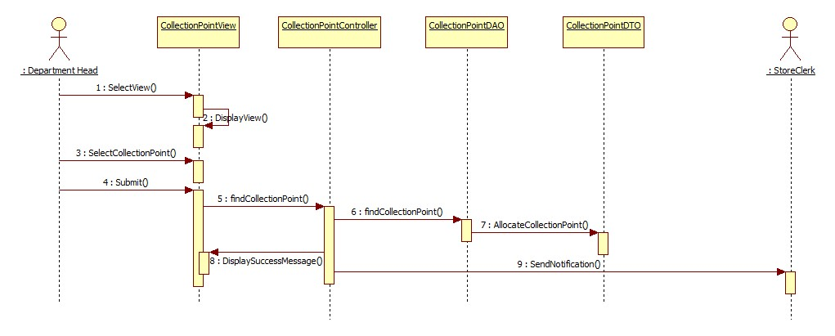
Appoint Collection Point

Slide 9
Department Android

Slide 10
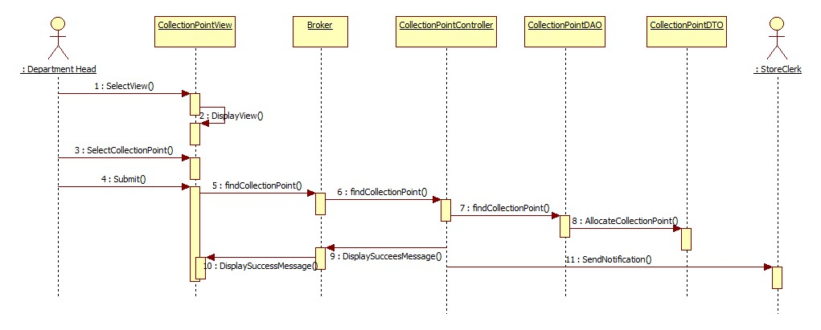
Appoint Collection Point

Slide 11
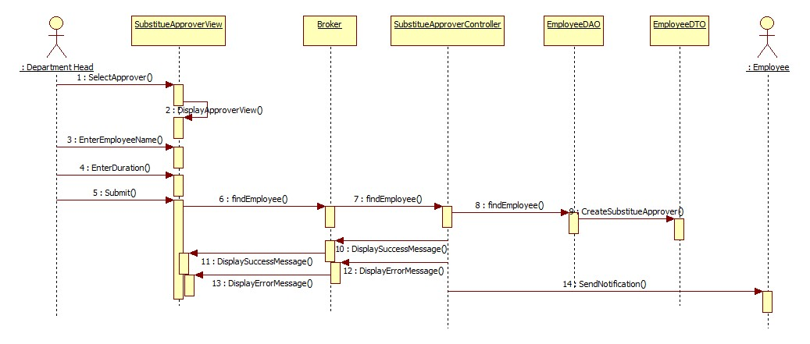
Appoint Substitute Approver and notification

Slide 12
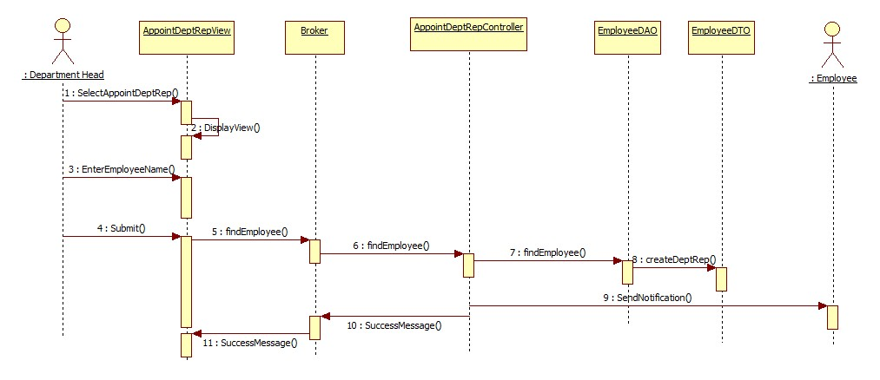
Appoint Department Representative

Slide 13
Store

Slide 14
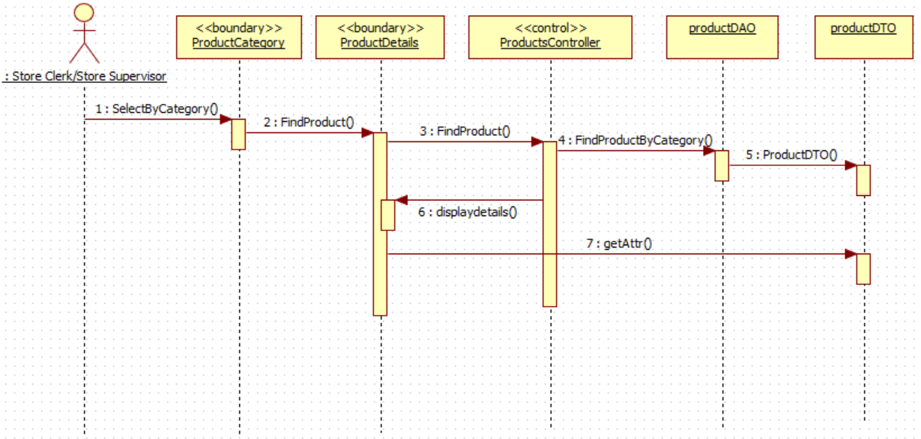
Retrieve Stationery/Product Info

Slide 15
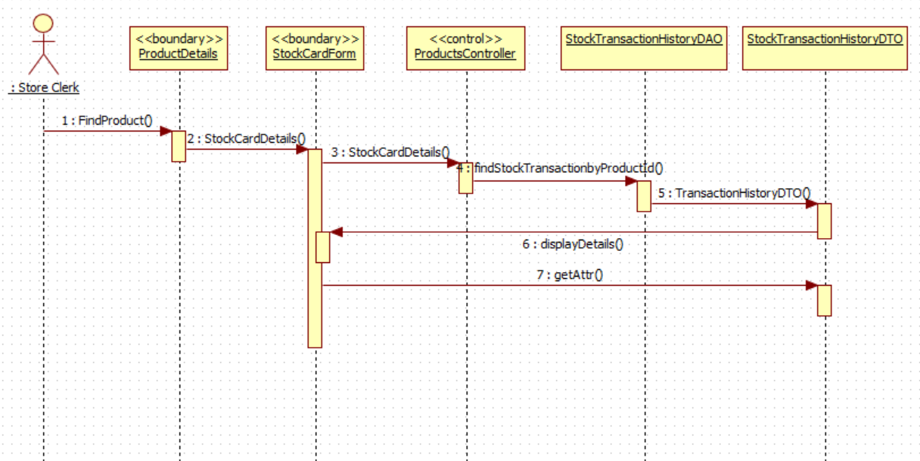
Retrieve Stock Card

Slide 16
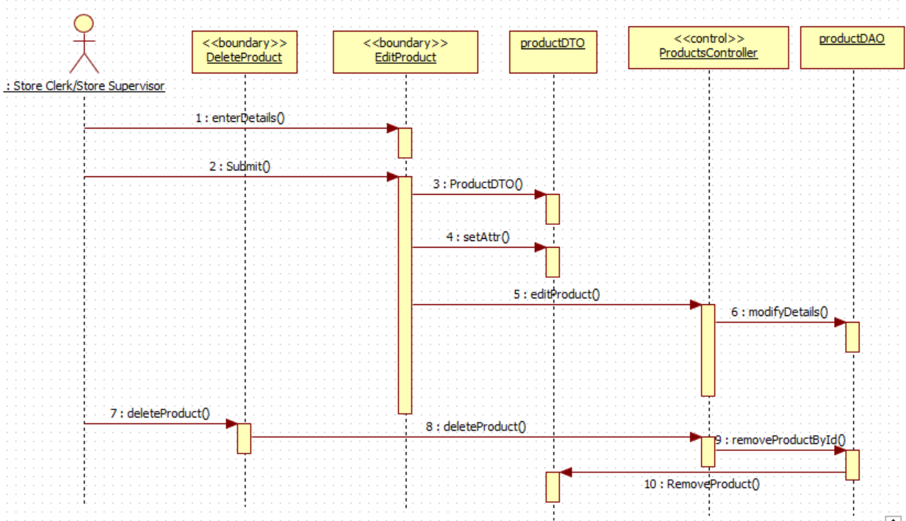
Maintain Stationery Details

Slide 17
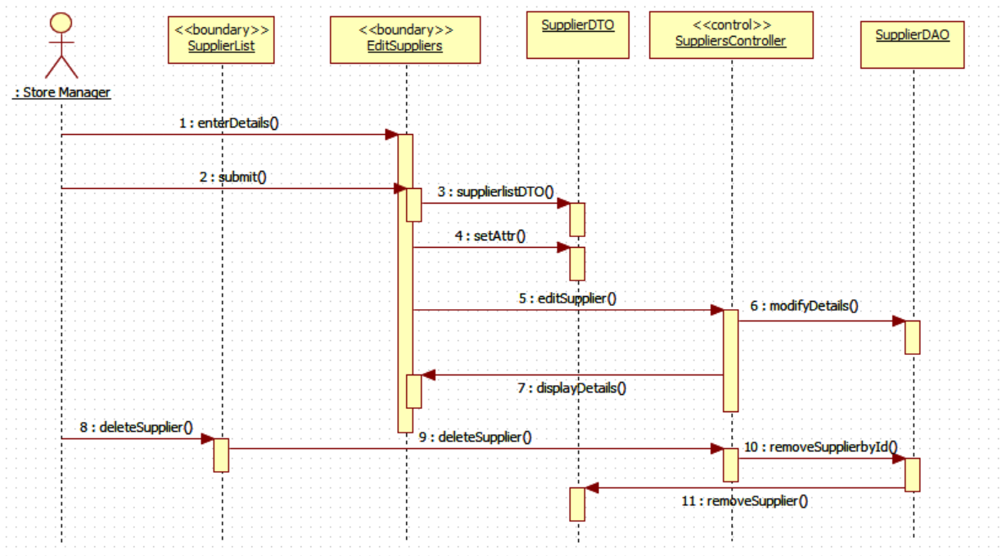
Maintain Supplier Details

Slide 18
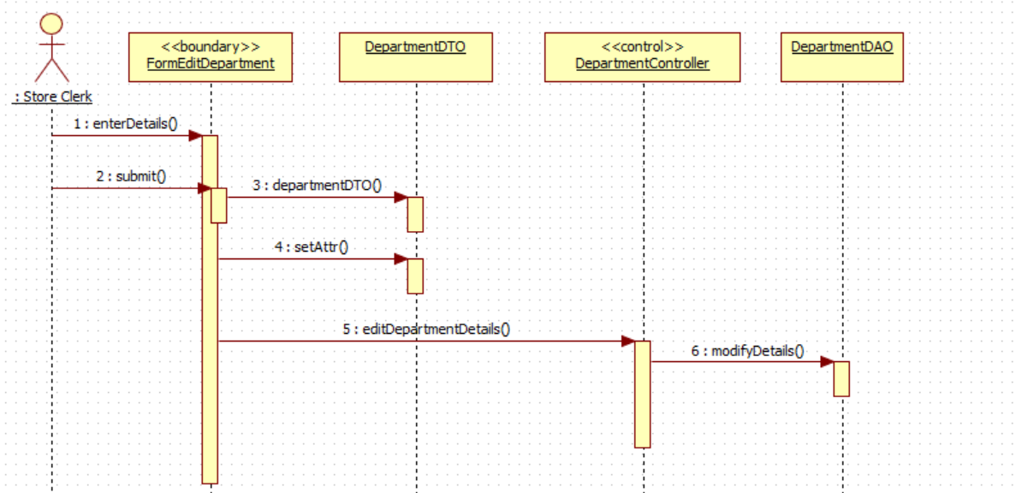
Maintain Department Details

Slide 19
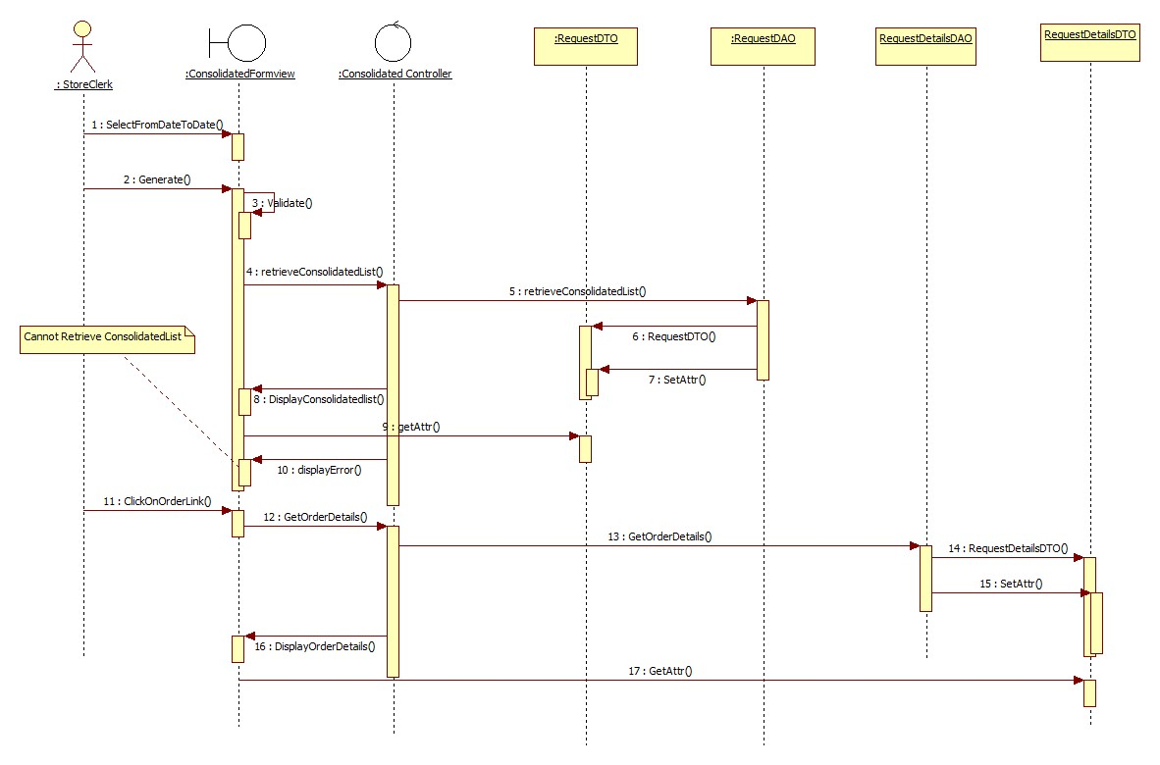
Consolidated Request List

Slide 20
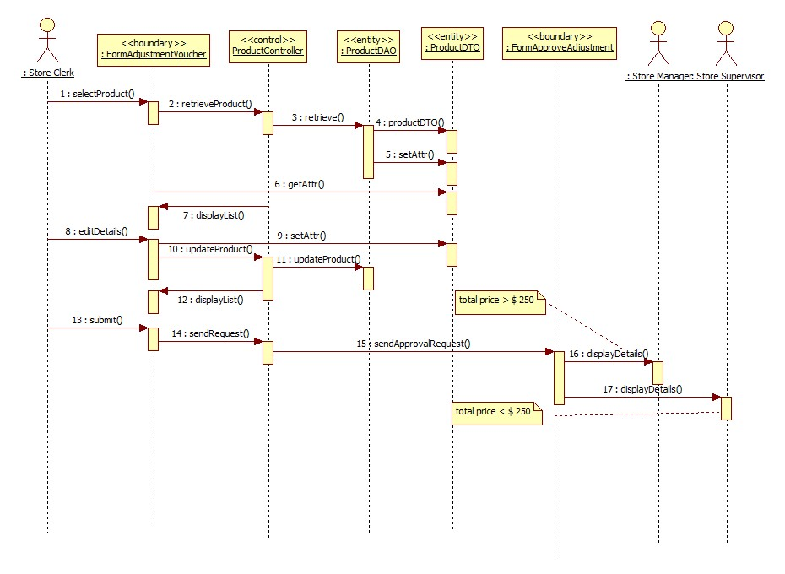
CREATE ADJUSTMENT VOUCHER

Slide 21
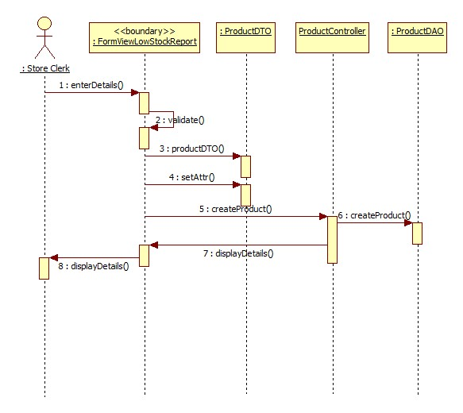
VIEW LOW STOCK INVENTORY

Slide 22
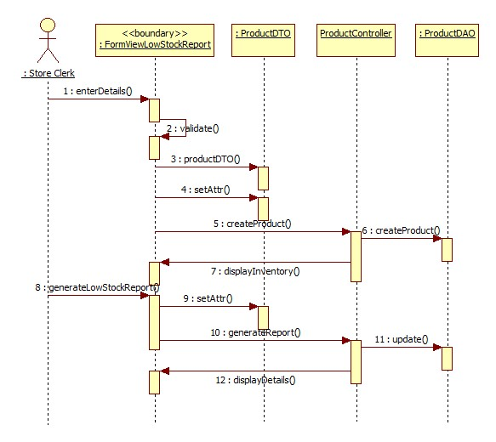
VIEW INVENTORY LIST

Slide 23
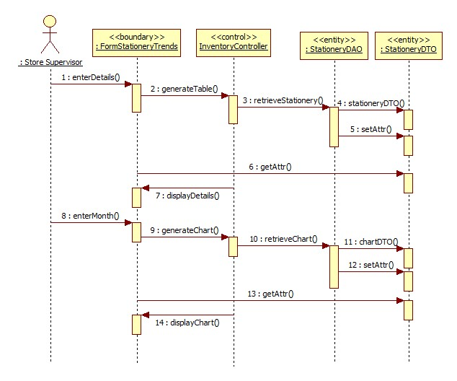
VIEW STATIONERY REQUISITION TRENDS

Slide 24
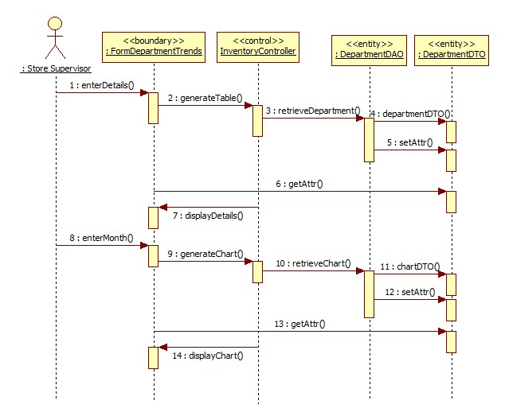
VIEW DEPARTMENT REQUISITION TRENDS

Slide 25
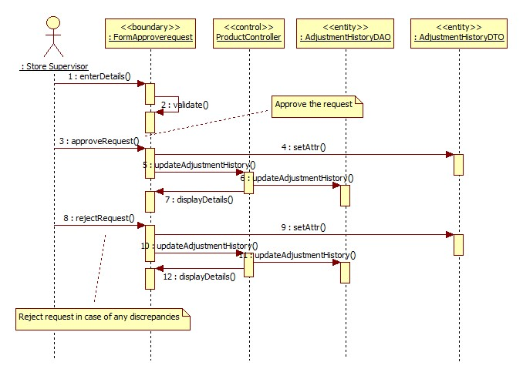
APPROVE ADJUSTMENT REQUEST- STORE SUPERVISOR

Slide 26
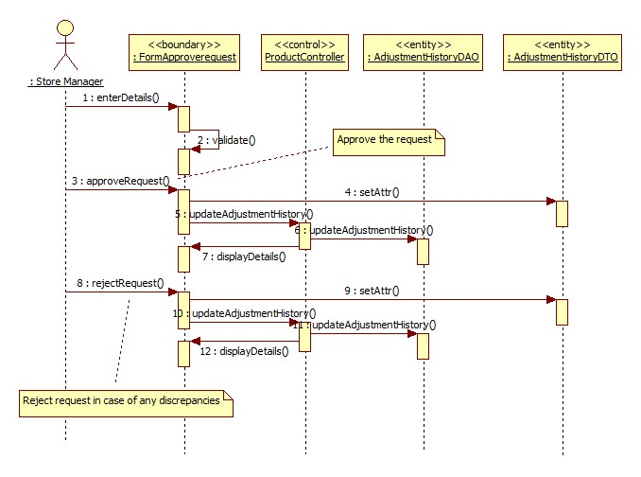
APPROVE ADJUSTMENT REQUEST - STORE MANAGER

Slide 27
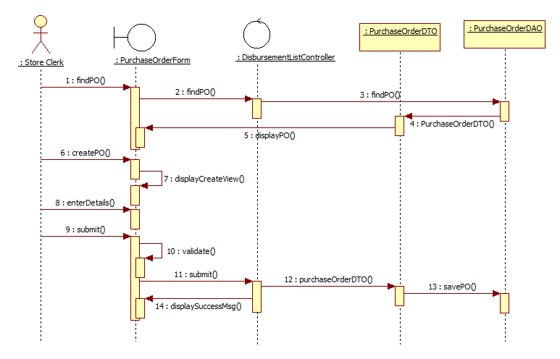
Maintain PO
Notes:
The Disbursement List Controller should be changed into the procurement controller

Slide 28
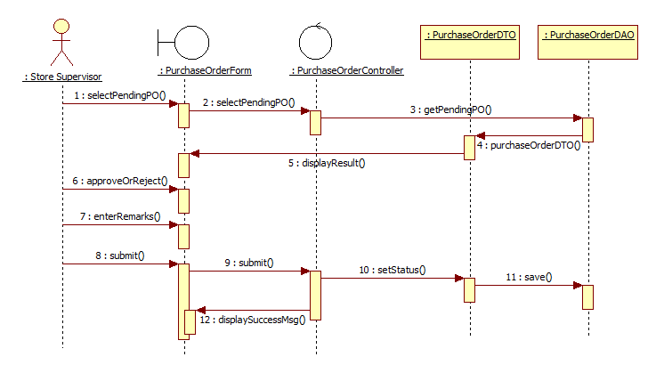
Approve PO

Slide 29
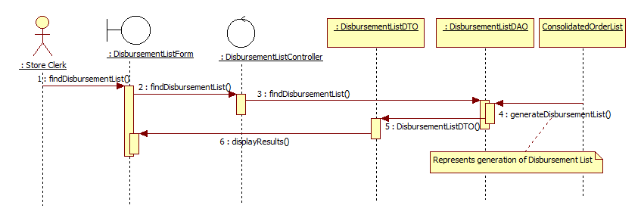
Maintain View Disbursement List

Slide 30
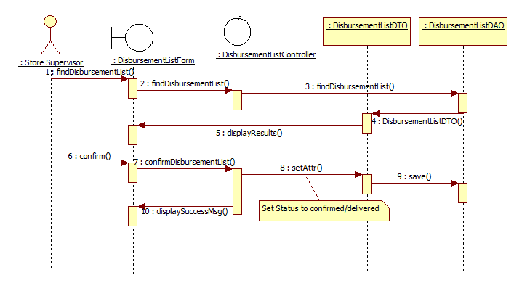
Confirm Disbursement List

Slide 31
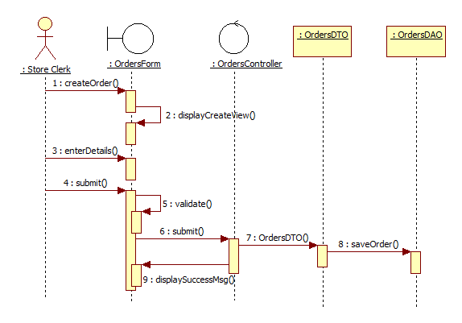
Create Outstanding Order

Slide 32
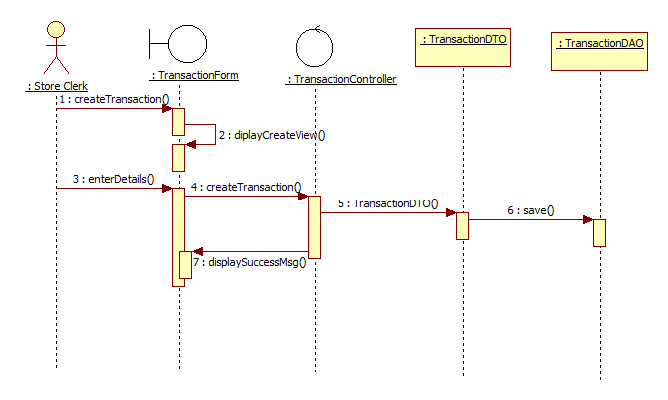
Update Item Quantity

